Slide 1
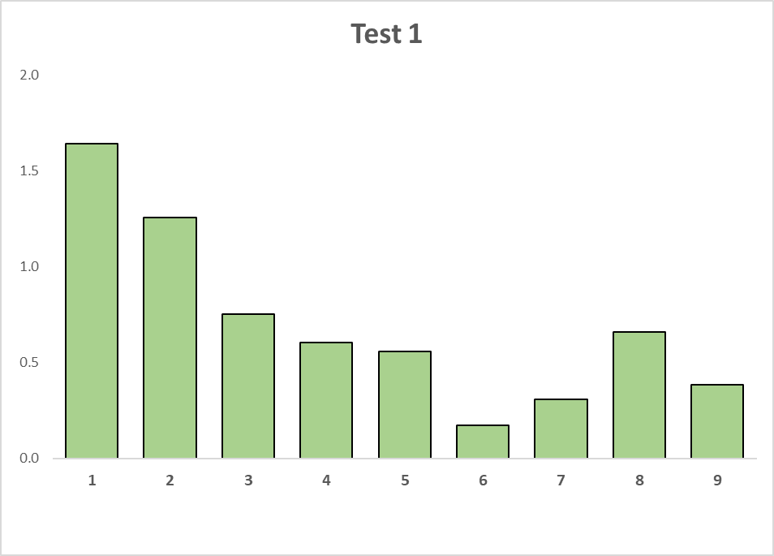
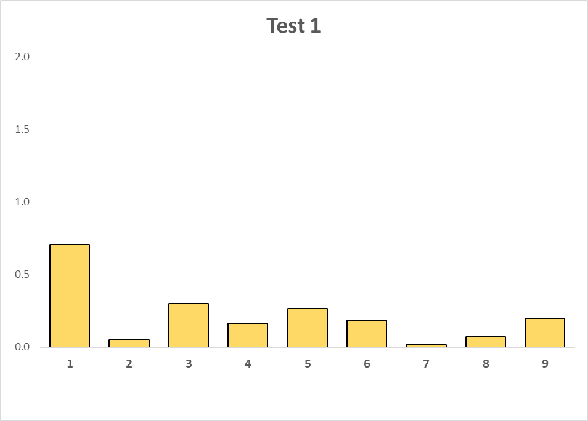
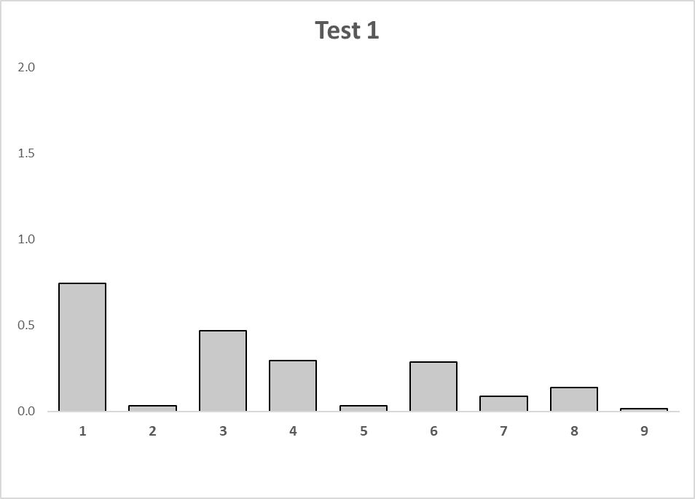
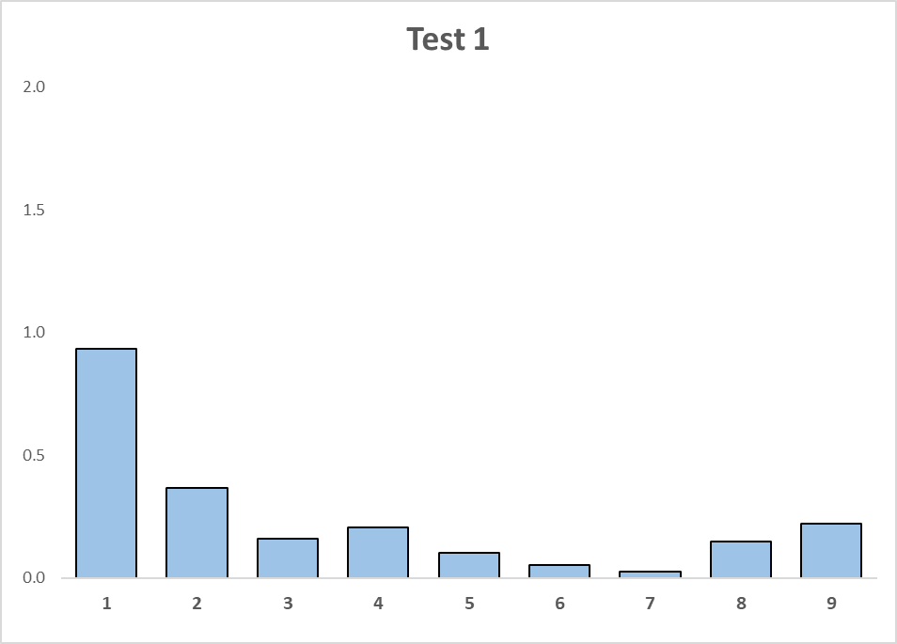
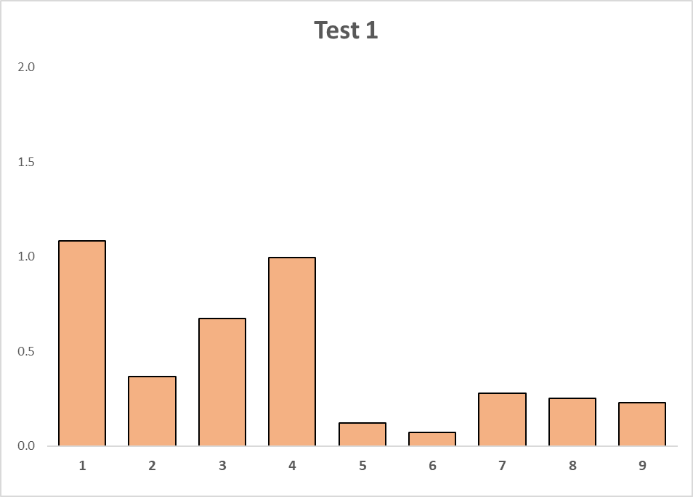
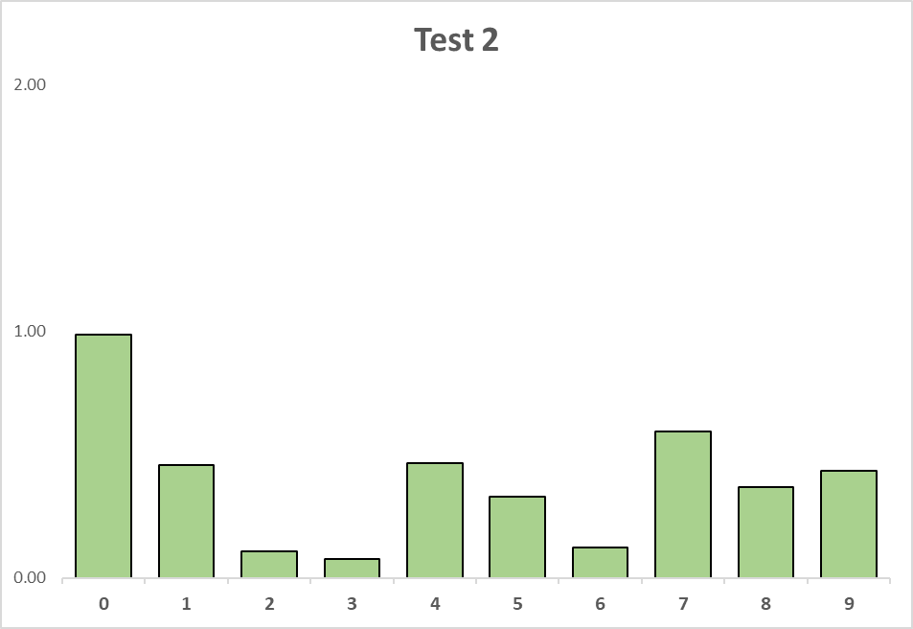
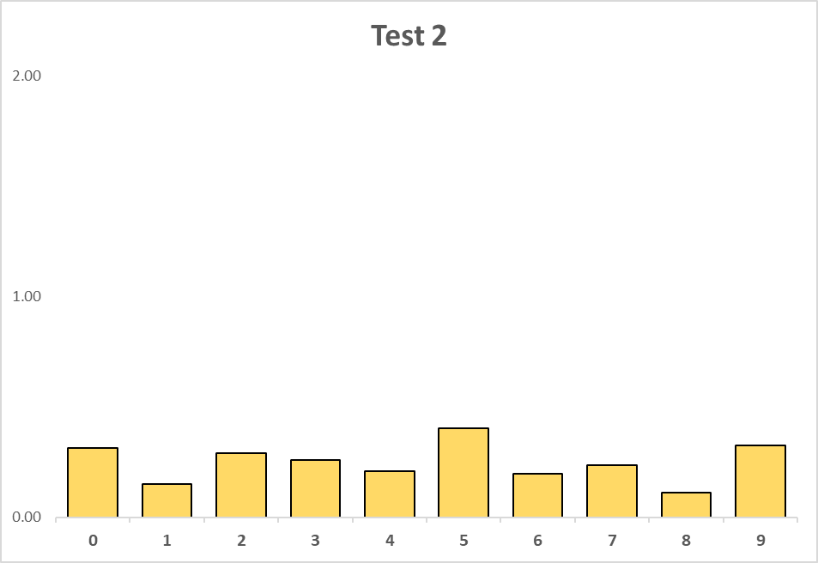
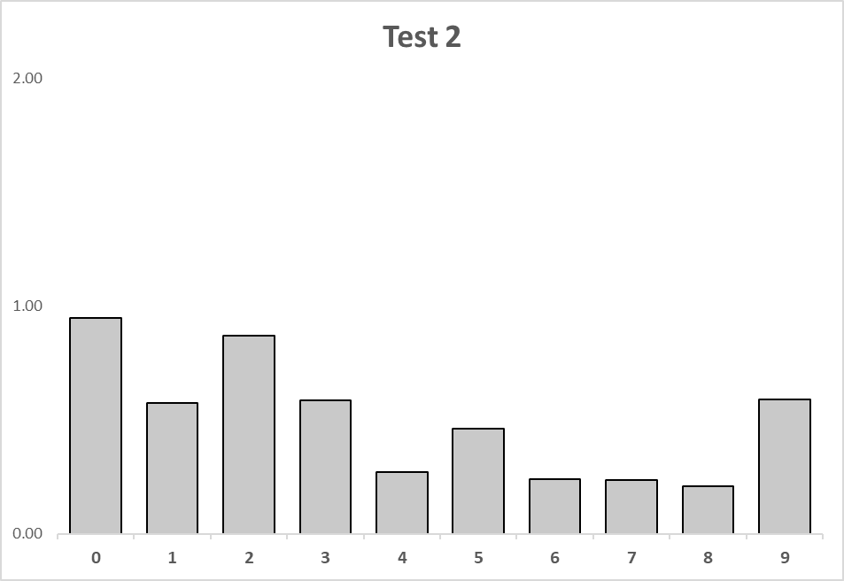
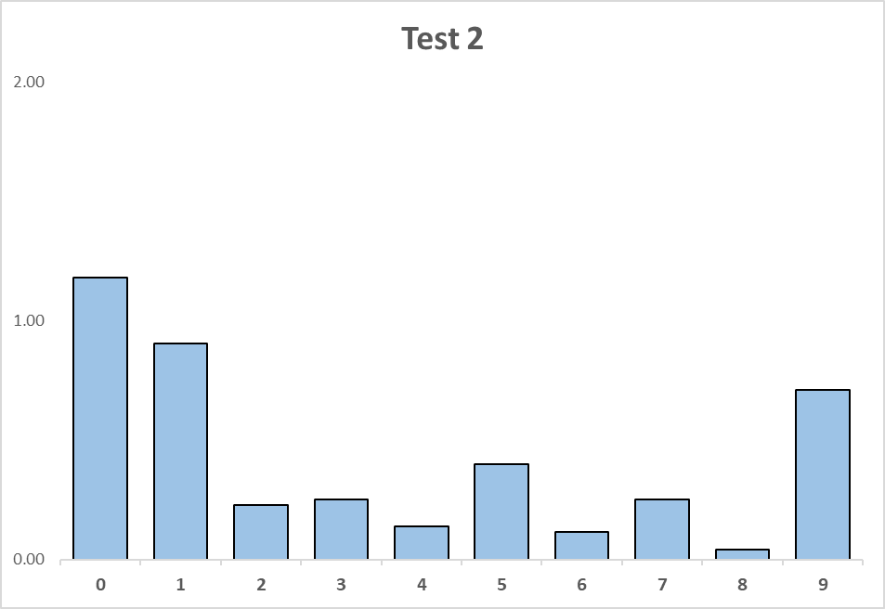
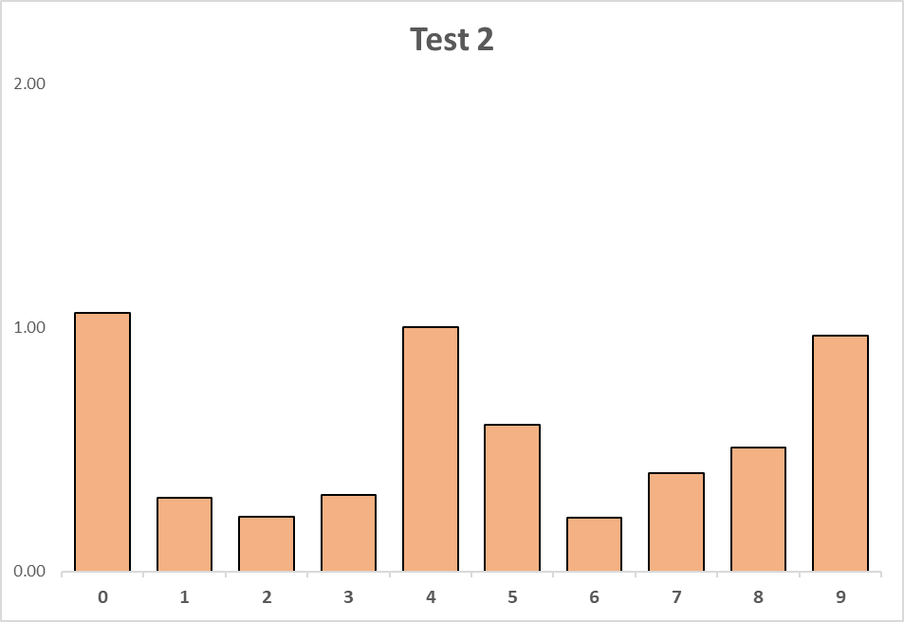
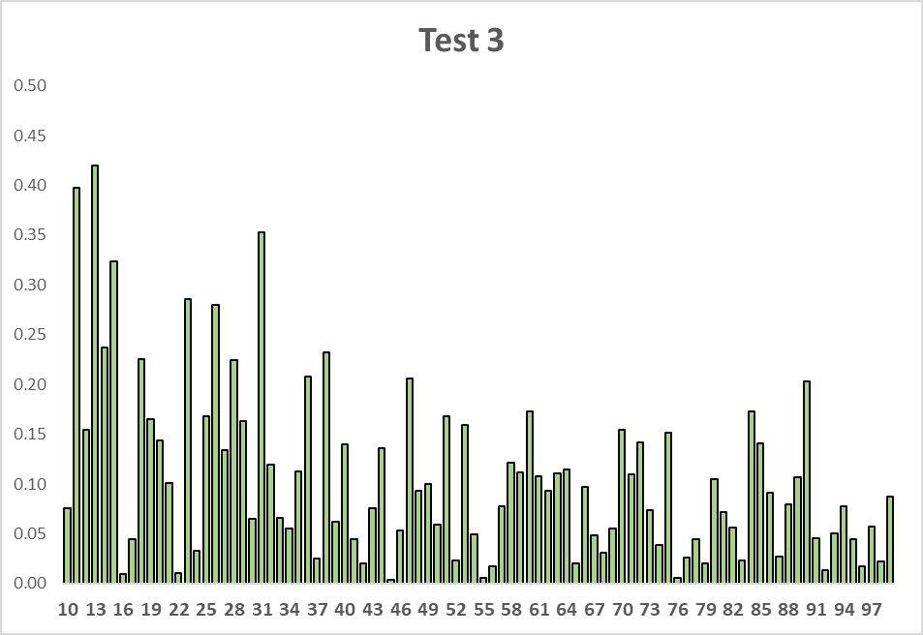
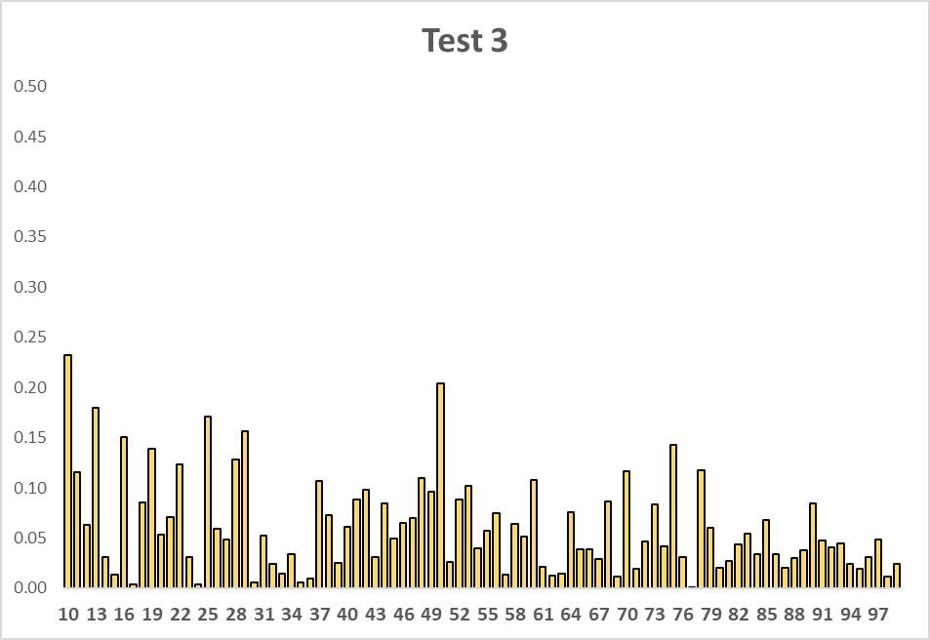
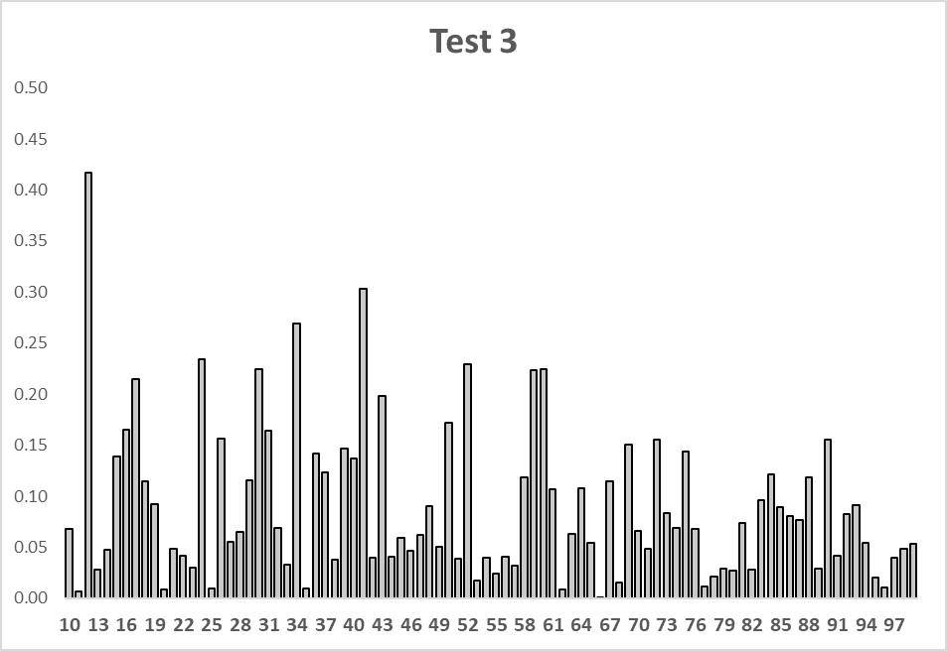
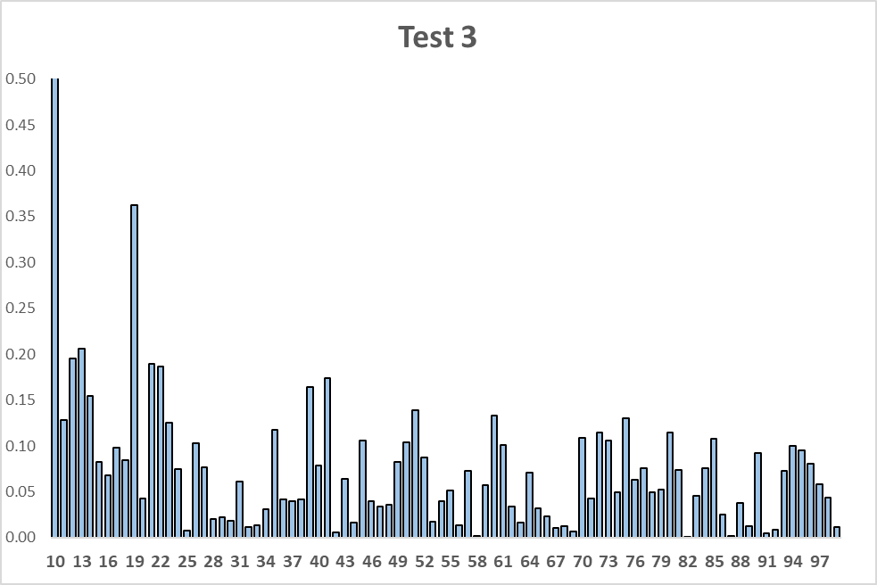
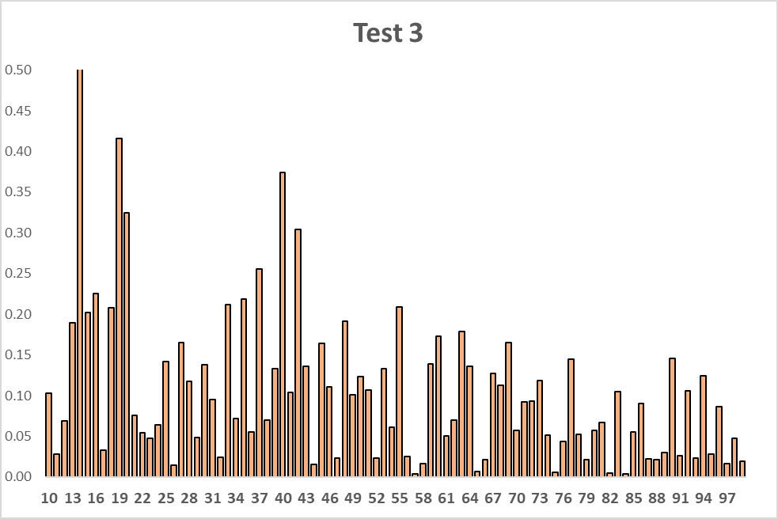




















N= 18,599
$D^{+}$=0.01644
$D^{−}$=0.01522
$V_{N}^{∗}$= 4.322
N= 29,606
$D^{+}$=0.00270
$D^{−}$=0.00707
$V_{N}^{∗}$= 1.682
N= 21,707
$D^{+}$=0.00773
$D^{−}$=0.00241
$V_{N}^{∗}$= 1.496
N= 21,686
$D^{+}$=0.00934
$D^{−}$=0.000
$V_{N}^{∗}$= 1.377
N= 17,589
$D^{+}$=0.00951
$D^{−}$=0.01082
$V_{N}^{∗}$= 2.699
N= 18,599
$D^{+}$=0.01510
$D^{−}$=0.00010
$V_{N}^{∗}$= 2.075
N= 29,606
$D^{+}$=0.00456
$D^{−}$=0.00015
$V_{N}^{∗}$= 0.811
N= 21,707
$D^{+}$=0.01510
$D^{−}$=0.00010
$V_{N}^{∗}$= 1.853
N= 21,686
$D^{+}$=0.01181
$D^{−}$=0.00010
$V_{N}^{∗}$= 1.756
N= 17,589
$D^{+}$=0.01061
$D^{−}$=0.00336
$V_{N}^{∗}$= 1.855
N= 18,599
$D^{+}$=0.01799
$D^{−}$=0.01570
$V_{N}^{∗}$= 4.600
N= 29,606
$D^{+}$=0.00393
$D^{−}$=0.00770
$V_{N}^{∗}$= 2.00
N= 21,707
$D^{+}$=0.01035
$D^{−}$=0.00231
$V_{N}^{∗}$= 1.868
N= 21,686
$D^{+}$=0.01286
$D^{−}$=0.00002
$V_{N}^{∗}$= 1.899
N= 17,589
$D^{+}$=0.01075
$D^{−}$=0.01092
$V_{N}^{∗}$= 2.877

